Slide 1


SMART PLANT WATERING SYSTEM
MADE BY:Hetanshi Kothari-18DIT029
Tanushree Kurup-18DIT030
Aditi Patel-18DIT044

Slide 2
LITERATURE REVIEW
The Smart plant watering system is an IoT based device which is capable of automating the watering process by analyzing the moisture of soil.
It will monitor the status of soil through sensors and provide signal for taking necessary actions.
Whenever we go out of town for few days, we always worry about our plants as they need water on regular basis. So here we are making Smart plant watering system which automatically provides water to our plants and keep us updated by sending message to our cell phone.

Slide 3
Continued…
This device improves plant irrigation in urban environments. Powered by an Arduino UNO, it uses on-board tools along with a moisture sensor to calculate optimum conditions for watering plants in its own environment, and then waters the plant itself at the calculated time.
We are using such a plant which will require a soil moisture of about 50-55%. So when the soil loses its moisture to less than 50% then Motor pump will turn on automatically to sprinkle the water and it will continue to sprinkle the water until the moisture goes upto 55% and after that the pump will be turned off.

Slide 4
CURRENT SYSTEM
Conventional irrigation methods use a lot of water, and needless to say, a lot of it is wasted on a daily basis. With the help of advanced methods of irrigation, which should ideally use just the correct amount of water needed for the plants, we could save a considerable amount of water. With the help of soil moisture sensors, we could use just the right amount of water needed for irrigation – and that is the motivation of this project.

Slide 5
PROPOSED SYSTEM AND SCOPE OF SYSTEM.
The Smart plant watering system has wide scope to automate the conventional system. Here we are building a IoT based plant watering System using ESP8266 NodeMCU Module and moisture Sensor. It will not only automatically irrigate the water based on the moisture level in the soil but also send the Data to device to keep track of the soil condition.
The System will consist a water pump which will be used to sprinkle water on the soil depending upon the moisture of the soil.
As technology is advancing, there is always a chance of reducing risks and making work simpler. Embedded and micro controller systems provide solutions for many problems. This application precisely controls water system for gardens by using a sensor micro controller system. It is achieved by installing sensors in the field to monitor the soil temperature and soil moisture which transmits the data to the microcontroller for estimation of water demands of plants.

Slide 6
Hardware And Software Requirements
HARDWARE:
Arduino Uno
NodeMCU ESP8266
Soil Moisture Sensor
Relay Module
5v DC motor
SOFTWARE:
Arduino IDE

Slide 7
GANTT CHART
start
Motorstatus==ON
Motor Off
Power detection
No power SMS alert
Soil Moisture
Motor Off
Motor On

Slide 8
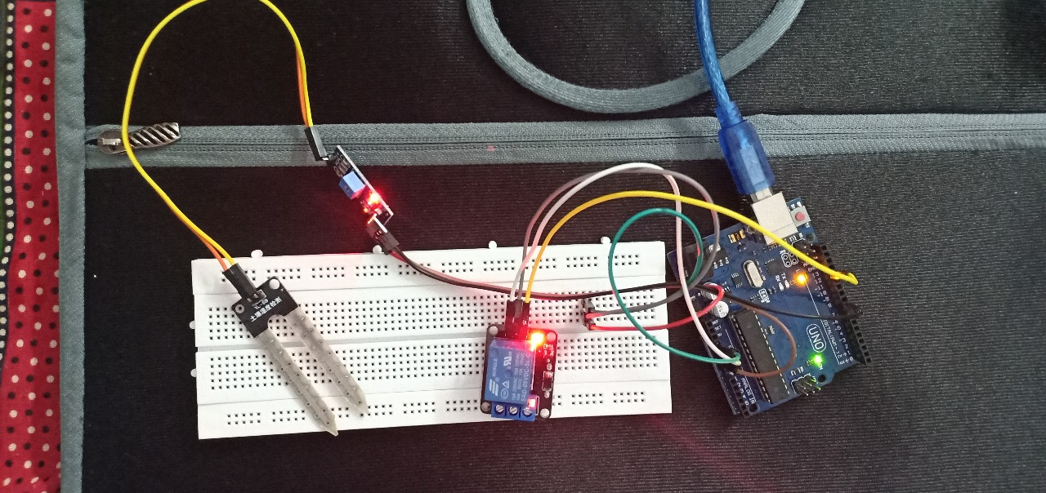
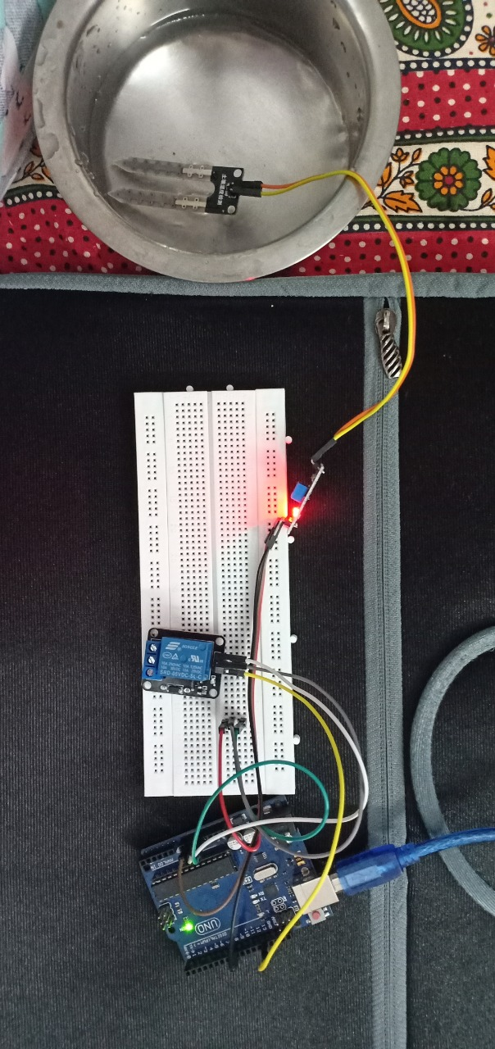
Implementaion

Slide 9
Limitation
Some of the limitations of smart plant watering system are:
Lack of accuracy in sandy soil due to their large particles.
Need of water for different soil are different,so it should be calibrated each time
Depends on Internet connectivity.

Slide 10
Conclusion
This project has a high social impact,in moderating the use of water.
Over-watering and under-watering affects the crop so proper amount of water should be supplied. By analyzing the soil parameters system waters the soil. So by this wastage of water reduced.
We can keep a track of the water requirements of our plants.
We can water their plants from anywhere in the world just by a single click on your device.

Slide 11
Reference
https://www.scribd.com/document/371585956/Arduino-Based-Automatic-Plant-Irrigation-System-With-Message-Alert
https://www.instructables.com/id/Automatic-Irrigation-System-for-Indoor-Gardening-U/
https://www.electronicsforu.com/electronics-projects/hardware-diy/automatic-plant-watering-system

Slide 12
THANK YOU

